Slide 1
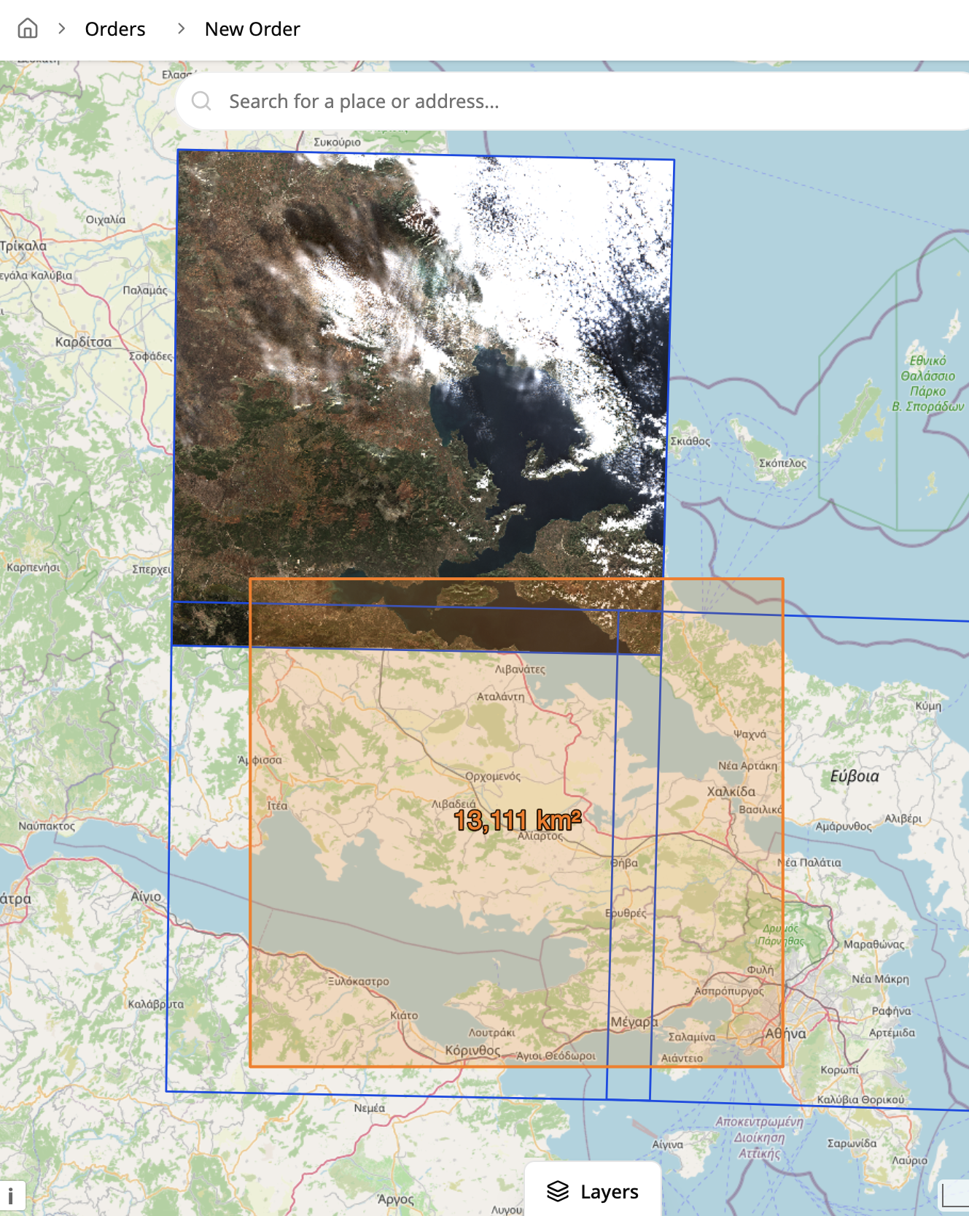




45th EARSeL SYMPOSIUM · ATHENS 2026
Hellenic Space Center DataHub
An Integrated Geographic Information System for Satellite Earth Observation Data
Efstathios Lymperis¹, Theodoros Vakkas¹, Dr. Panagiotis Symeonidis¹, Dr. Angelos Tzotsos², Michael Alexakis², Ioannis Kouvaras², Prof. Konstantinos Karantzalos³, Dimitris Bliziotis⁴
¹ Geospatial Enabling Technologies Ltd. ² EOFarm P.C. ³ Secretary General of Telecommunications & Post, Ministry of Digital Governance & AI ⁴ Hellenic Space Center (HSC)
elymperis@getmap.gr
Notes:
[~0:30 | running total 0:30]
Good morning. I will present the HSC DataHub, the Integrated Geographic Information System we built for the Hellenic Space Center to store, manage and securely distribute high-resolution satellite Earth Observation data to the Greek Public Sector. The work was carried out by GET and EOFarm under an ESA contract, within Greece’s National Microsatellite Program.

Slide 2





CONTEXT
Part of Greece’s National Microsatellite Program
Greece’s primary initiative for autonomous space capabilities and EO services. Implemented by the Ministry of Digital Governance & AI through the General Secretariat of Telecommunications and Post, with ESA and HSC, funded by “Greece 2.0”.
Where HSC’s DataHub fits
HSC’s Satellite EO Mission Programming Services task high-resolution commercial sensors for systematic mapping and emergency monitoring. The DataHub takes the requests, catalogues the imagery and delivers it securely to Public Sector users.
7
optical microsatellites
4
thermal microsatellites
2
SAR microsatellites
11
CubeSats for in-orbit validation
Environment & Energy
Civil Protection
Cartography
Agriculture & Food
24 satellites, plus optical ground stations, a space tracking radar and an AIT facility. Axis 3 adds the Governmental Hub and downstream services.
HSC DataHub · EARSeL Athens 2026 2
Notes:
[~0:50 | running total 1:20]
This work sits inside Greece’s National Microsatellite Program, the country’s main initiative for autonomous space capabilities, run by the Ministry of Digital Governance and AI through the General Secretariat of Telecommunications and Post, with ESA and the Hellenic Space Center, and funded by Greece 2.0. It brings 24 satellites: seven optical, four thermal, two SAR microsatellites and eleven CubeSats, plus ground infrastructure; Axis 3 adds the Governmental Hub. Alongside that, HSC runs mission programming services that task commercial sensors for systematic mapping and emergencies. HSC’s DataHub is the system that manages those requests and delivers the data to the Public Sector.

Slide 3






PURPOSE
What HSC’s DataHub is for
A system to manage, track and centralise all operations for commercial satellite data acquisition and dissemination in the Greek Public Sector.
It is the central tool HSC uses to receive and process order requests, and to document and catalogue every deliverable.
HSC’s DataHub
order requests
Receive & approve requests
Track every order
tasking orders
Public Sector users
public bodies and the scientific community
Commercial providers
optical, thermal and SAR satellite operators
Catalogue deliverables
Disseminate products
products
deliveries
Manage
Every order request, from submission and approval to fulfilment, through configurable workflows
Track
Each stage recorded with timestamps and visible to requesters and HSC staff
Centralise
One documented, searchable record of all commercial data acquired for the Public Sector
HSC DataHub · EARSeL Athens 2026 3
Notes:
[~1:00 | running total 2:20]
So what exactly is the DataHub? It is the system that manages, tracks and centralises everything around commercial satellite data for the Greek Public Sector. Public bodies send their order requests to HSC through it; HSC approves them and places tasking orders with commercial providers; the deliveries come back into the DataHub, where they are documented and catalogued, and from there the products are disseminated to the requesting bodies. In short, it is the central tool HSC uses to receive and process order requests, and to document and catalogue every deliverable, so there is one complete record instead of scattered e-mails and files.

Slide 4

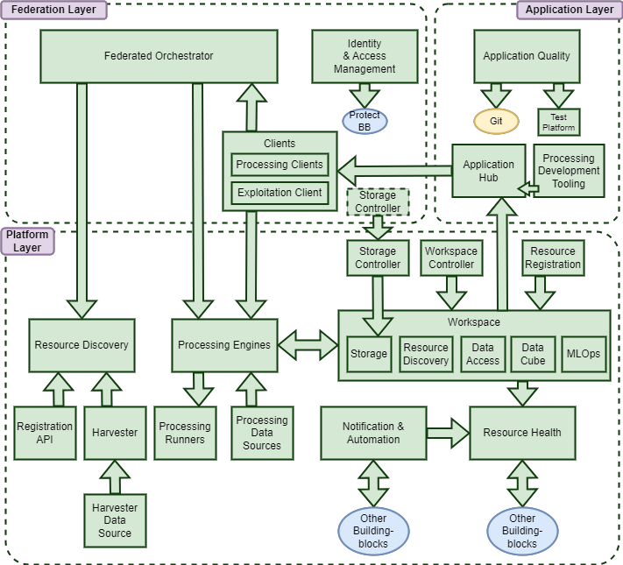




METHODOLOGY
Built on ESA’s EOEPCA Common Architecture
Standardised, reusable building blocks for federating heterogeneous EO resources in cloud-native environments. We adopted v2.0 for longer upstream support.
EOEPCA building block
Our implementation
Resource Discovery
pycsw catalogue
Data Access
TiTiler
Resource Registration
pygeoapi Registration API + Harvester
Identity & Access
Keycloak
Workspace
Shared S3 storage, no per-user workspace
EOEPCA partners. EOFarm, now merged with GET, has been a project partner in both phases, EOEPCA and EOEPCA+, with domain expertise in the resource catalogue (pycsw).
EOEPCA 2.0 reference architecture
HSC DataHub · EARSeL Athens 2026 4
Notes:
[~0:50 | running total 3:10]
HSC’s DataHub follows EOEPCA, ESA’s Common Architecture, which defines open interfaces and reusable building blocks so that heterogeneous EO resources can be federated. We moved to EOEPCA 2.0 during the project for longer upstream support. We used the Resource Discovery, Data Access and Resource Registration building blocks and EOEPCA user management. We know EOEPCA from the inside: EOFarm, now merged with GET, has been a project partner in both phases of EOEPCA, the original EOEPCA and the current EOEPCA+, alongside ESA, Telespazio UK and others, and our domain expertise is the resource catalogue, pycsw. One deliberate deviation: instead of the EOEPCA Workspace, which provisions a workspace per user, we used shared S3 object storage, because HSC did not need per-user workspaces and this saves resources.

Slide 5

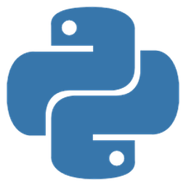



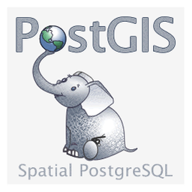






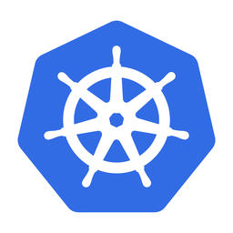




METHODOLOGY
Open source and open standards at the core
EOEPCA building blocks
Open-source reference components, reused as-is
STAC as the backbone
pycsw
TiTiler
pygeoapi
Registration Harvester
Keycloak
Catalogue backbone: every product is a STAC item, served through STAC API alongside OGC API – Records, CSW and OpenSearch
Generated by the harvester: providers rarely deliver STAC, so we create it from each delivery
Shared language: components describe and pass products to each other as STAC
Future-ready: a standard model leaves room for new integrations
Our platform services
Built on open-source frameworks
Django
React
PostgreSQL
PostGIS
Flowable
Redis
Celery
APISIX
Closed catalogue: access only for authorised DataHub users.
Open standards & protocols
Operations
Open-source cloud-native tooling
STAC
OpenAPI
OpenID Connect
COG
Kubernetes
Helm
Argo CD
Prometheus
Grafana
OGC API
CSW
OAuth 2.0
HSC DataHub · EARSeL Athens 2026 5
Notes:
[~1:00 | running total 4:10]
Open source is not an add-on here; it is the foundation on both sides. EOEPCA itself is a set of open-source reference components, and we reused them directly: pycsw, TiTiler, pygeoapi, the registration harvester and Keycloak. Our own services are built on open-source frameworks, and operations use the standard cloud-native toolchain. The glue is open standards, above all STAC. STAC is the backbone of the catalogue: every product is described as a STAC item. Providers rarely deliver STAC, so our harvester creates it from each delivery. STAC is also how our own components describe products and pass them to each other, and because it is a standard, it gives us the flexibility to add integrations in the future. Note that the catalogue itself is closed: only authorised DataHub users can access it.

Slide 6
ARCHITECTURE
System architecture: four layers, three subsystems
Presentation
DataHub UI · search, view, order
ERM back-office · requests, approvals, admin
Middleware
Apache APISIX API gateway · routing, TLS, authentication, rate limiting, metrics
Services
Request Management & Distribution (ERM)
Storage & Management of Geospatial Data
Authentication & Authorization (AAI)
Core API (Django)
Catalogue (pycsw)
Keycloak (OIDC, RBAC)
Flowable BPM engine
Data Access (TiTiler)
TAXISnet identity broker
Notifications · Chat · Storage services
Registration API · Harvester
Policy enforcement at gateway
Infrastructure
Kubernetes on DAEDALUS
S3 object storage
PostgreSQL / PostGIS
Redis
Prometheus · Grafana
HSC DataHub · EARSeL Athens 2026 6
Notes:
[~1:00 | running total 5:10]
This is the overall architecture. At the top, two web applications: the DataHub UI where users search, view and order data, and the ERM back-office for request handling and administration. All traffic passes through an Apache APISIX gateway. Below are the three subsystems, which are independent but interconnected through APIs. Everything runs as containers on a Kubernetes cluster running on DAEDALUS, the national supercomputer, with S3-compatible object storage for imagery and PostgreSQL/PostGIS for application data. The ERM itself is a Django and React application, using Redis and Celery for asynchronous work.

Slide 7
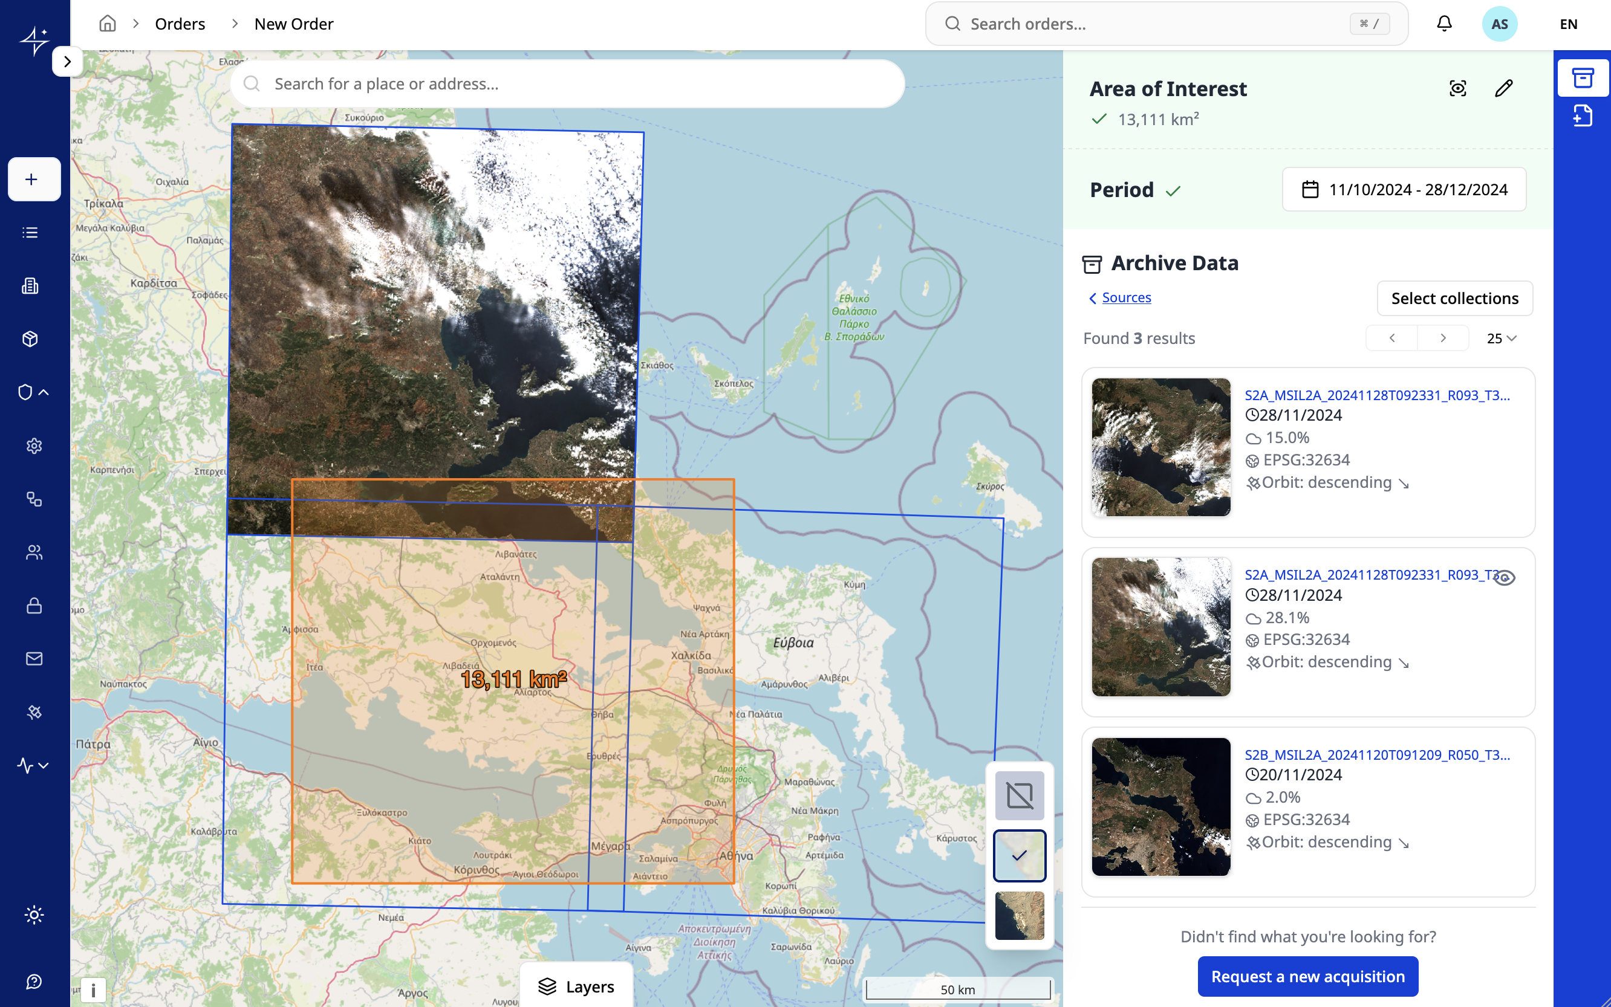

SUBSYSTEM 1 · REQUEST MANAGEMENT
Placing a request: a map-first, two-step wizard
1
Where, when, what
Draw the area of interest, or drag-and-drop shp, kml, gpx or GeoJSON
Pick the time window
Choose optical/multispectral, thermal or SAR
2
Specify the product
Spatial resolution, provider and product
Cloud cover and off-nadir angle
Orthorectification or mosaicking
Intended use; urgency with justification
Archive first, tasking second. A past date range searches the HSC archive; if nothing fits, “Request a new acquisition” starts a new order.
DataHub UI: area of interest, period and matching HSC archive data
HSC DataHub · EARSeL Athens 2026 7
Notes:
[~0:50 | running total 6:00]
Requests start on a map. In step one the user draws or uploads an area of interest, picks a time window and a data category: optical or multispectral, thermal, or SAR. Step two sets the technical parameters: resolution, provider and product, cloud cover, off-nadir angle, post-processing like orthorectification or mosaicking, the purpose of use, and whether the request is urgent. If the time window is in the past, the user can directly search and request data already in the HSC archive, which avoids unnecessary new acquisitions.

Slide 8
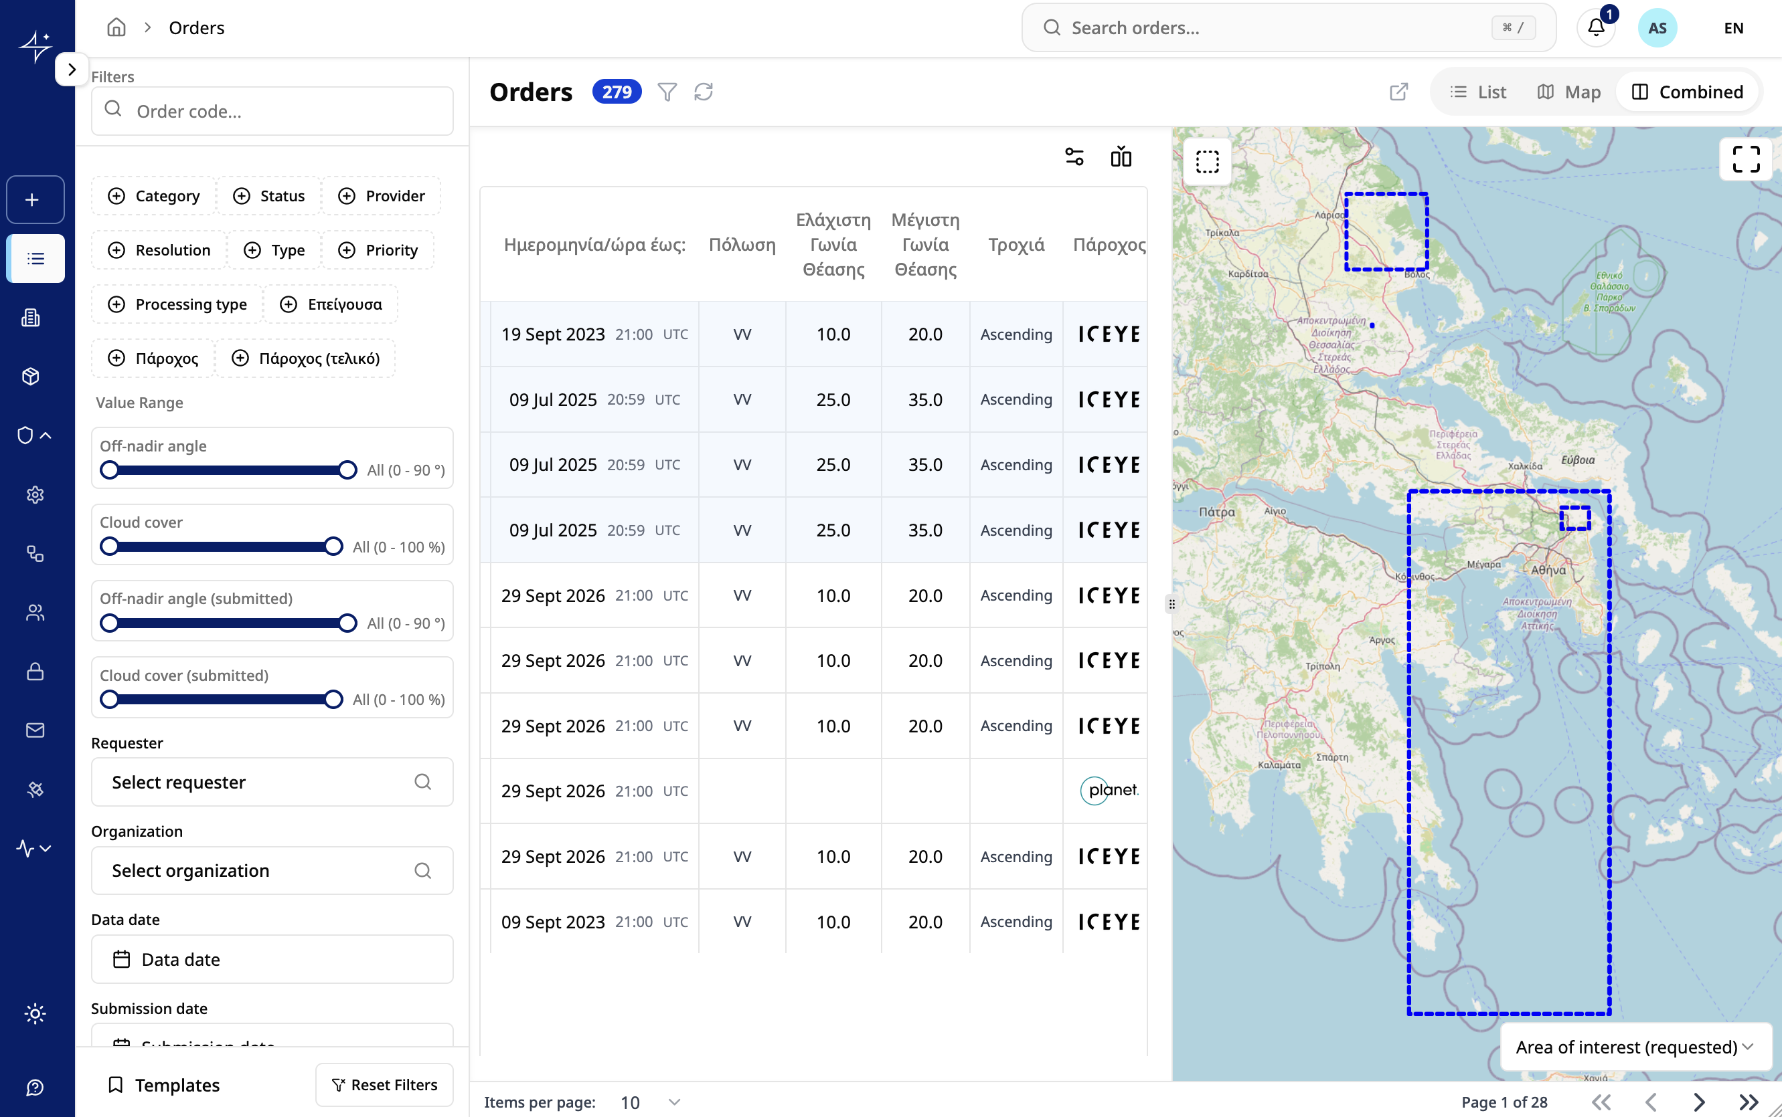



SUBSYSTEM 1 · REQUEST MANAGEMENT
Managing the full request lifecycle
From submission to fulfilment, every stage is recorded with timestamps. Views adapt to user role and organisation.
Approval workflows
Modelled in a node-based designer; designated users approve or reject with justification
Automated notifications
Rule-based e-mails from WYSIWYG templates with dynamic fields
Built-in support chat
Per-request messaging; unread messages trigger e-mail reminders
Operational reporting
Orders in combined list and map view, filterable by category, status, provider, requester, organisation and dates
Analytics on volume, type and requesting bodies
HSC DataHub · EARSeL Athens 2026 8
Notes:
[~0:50 | running total 6:50]
Once submitted, a request is tracked through its whole lifecycle. Administrators see all requests in list, map or combined views, colour-coded by status, with filtering and sorting. Approval happens inside the workflow; a decision immediately updates the database and triggers the next actions, such as notifying the requester. E-mail templates are edited in a WYSIWYG editor, each request has its own support chat, and an analytics module reports on usage. Requests can also be duplicated to submit similar ones quickly.

Slide 9
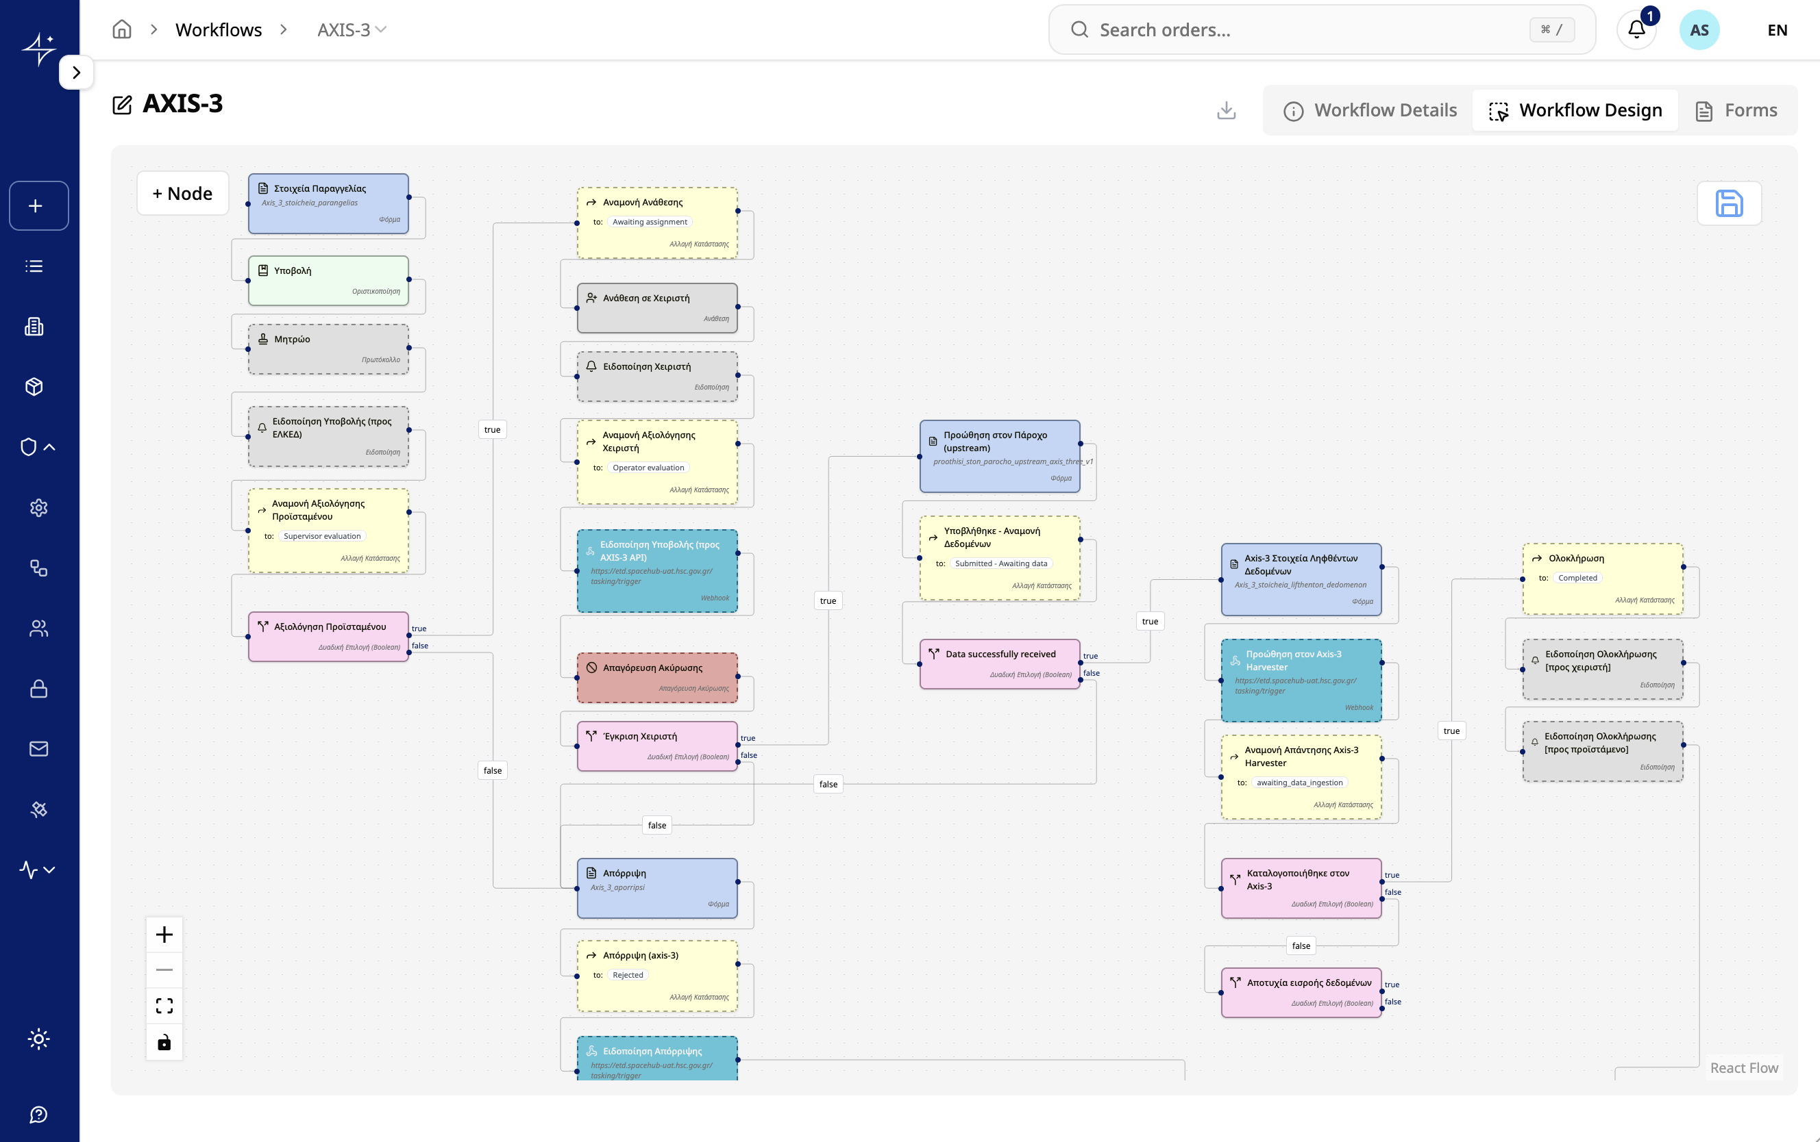

SUBSYSTEM 1 · REQUEST MANAGEMENT
No-code workflows: one DAG per order type
Order types
1
Archive data order
data already in the HSC archive
2
New data order
new acquisition from commercial sensors
3
Tasking from Axis-3
requests arriving from the Governmental Hub
Node types
Form
Notification
State change
Decision
Webhook
Assignment
The workflow is the business process. Each order type is a DAG that models HSC’s operational steps clearly and unambiguously, so what the system runs is exactly what the procedure says.
“Tasking from Axis-3” workflow in the ERM node-based designer
HSC DataHub · EARSeL Athens 2026 9
Notes:
[~1:00 | running total 7:50]
Behind the lifecycle is a no-code workflow designer, and the key idea is that the workflow is the business process. Each order type is its own workflow: an archive data order, a new data order for fresh acquisitions, and tasking that arrives from the Axis-3 Governmental Hub. Every workflow is a directed acyclic graph of nodes: forms, notifications, state changes, assignments, and decision nodes whose true or false outcomes branch the flow. Because the graph has no cycles, every request is guaranteed to reach an end state. These graphs model HSC’s operational steps explicitly and unambiguously: there is no gap between the documented procedure and what the system executes. What you see is the Tasking from Axis-3 workflow: submission and supervisor approval, assignment and operator evaluation, a webhook that notifies the Axis-3 API, forwarding to the provider, waiting for the data, a webhook that triggers the Axis-3 harvester, and completion once Axis-3 confirms the data is catalogued. Because this logic is configuration rather than code, HSC can add order types or change procedures without redevelopment.

Slide 10
SUBSYSTEM 2 · STORAGE & MANAGEMENT
Standards-based discovery, access and ingestion
Resource Discovery
Data Access
Resource Registration
Workspace
pycsw 2.6
TiTiler
pygeoapi + Harvester
S3 object storage
OGC API – Records
STAC API 1.0 / 1.1
OGC CSW 2.0.2 / 3.0.0
OpenSearch Geo/Time
OGC reference implementation
Cloud-Optimized GeoTIFF
OGC API – Tiles / Maps
XYZ tiles, TileJSON
Previews and statistics
FastAPI + rio-tiler
Create, update, delete catalogue resources
STAC items and collections
Flowable BPMN ingestion flow
Shared S3-compatible buckets
Replaces EOEPCA Workspace
High availability, IAM policies
Download via S3 / FTP clients
Deployed from EOEPCA Helm charts onto the project’s Kubernetes cluster
HSC DataHub · EARSeL Athens 2026 10
Notes:
[~1:00 | running total 8:50]
The storage and management subsystem is where EOEPCA is most visible. Discovery uses pycsw, the EOEPCA reference catalogue and an OGC reference implementation, exposing OGC API Records, STAC API, CSW and OpenSearch from one catalogue. Data access uses TiTiler, serving tiles on the fly from Cloud-Optimized GeoTIFFs through OGC API Tiles and Maps. Registration uses the pygeoapi-based EOEPCA Registration API, fed by a harvester. And the workspace is shared S3 storage. All components were installed from the upstream EOEPCA Helm charts.

Slide 11

SUBSYSTEM 2 · INGESTION PIPELINE
From provider delivery to searchable catalogue record
1
2
3
4
Delivery lands in S3
Create STAC items
Publish to catalogue
Notify ERM
Flow starts with provider, s3_path and order_id
Generated from the delivered data, with metadata extracted by Rasterio
Insert new records in pycsw, or update existing ones
Request is marked fulfilled and the user is informed
Process engine
Flowable BPMN embedded in a Spring Boot service, with custom, narrowly scoped endpoints so external services never see the full Flowable API.
Data Harvester worker (Python)
External-task pattern, extended with OAuth2/JWT, automatic reconnection, HTTP retries with backoff, and per-task YAML configuration.
Provider collections configured
Airbus
Capella
ICEYE
Maxar
OroraTech
PlanetScope
SkySat
Cadastre
HSC DataHub · EARSeL Athens 2026 11
Notes:
[~0:50 | running total 9:40]
When a provider delivers imagery to S3, the ERM starts a BPMN process with the provider, the S3 path and the order ID. The process creates STAC items from the delivered data, extracting the metadata with Rasterio, since providers rarely supply STAC themselves; publishes them to the catalogue, inserting or updating; and finally notifies the ERM so the request is fulfilled. The engine is Flowable in Spring Boot. The worker is Python, following the external-task pattern, and we added OAuth2, reconnection, retries and YAML configuration. Eight provider collections are configured today.

Slide 12



SUBSYSTEM 3 · AUTHENTICATION & AUTHORIZATION
One identity, fine-grained access
bpm-engine
Open protocols, single sign-on
OAuth 2.0, OIDC and SAML 2.0, with local and global sign-out
harvester
erm-core
Role-based access control
Roles for users and service accounts; groups map to organisations
Keycloak 26
realm “HSC”
Verified onboarding
New accounts stay inactive until an administrator verifies them; optional TOTP/HOTP 2FA
erm-storage
erm-chat
Public-sector login
Keycloak SPI extension brokers Public Administration credentials
TAXISnet identity provider
OIDC clients: authorization-code flow for web apps, client-credentials for backend services
Roles: Administrator · Head · Operator · Supervisor · Public bodies · Scientific community
HSC DataHub · EARSeL Athens 2026 12
Notes:
[~0:50 | running total 10:30]
The third subsystem is based on EOEPCA user management, implemented with Keycloak 26 in an isolated HSC realm. Every subsystem is an OIDC client: web applications use the authorization-code flow and backend services use client credentials, so even service-to-service calls such as ERM to the BPM engine are role-controlled. Public servants can log in through TAXISnet via a custom Keycloak extension. New accounts are inactive until an administrator verifies them, 2FA is available, and credentials are stored hashed with PBKDF2-SHA256.

Slide 13

NATIONAL MICROSATELLITE PROGRAM
Integration with the Axis-3 Governmental Hub
1 User federation
between the two platforms’ Keycloak identity servers
2 Coordinated order management
through a dedicated integration API
↔
Axis-3 Governmental Hub
1
Follows the order’s progress
5
Service run (e.g. flood delineation) builds a data manifest
Harvests the delivered data
tasking request
status updates
start harvesting
harvest complete
HSC’s DataHub
2
3
4
6
Tasking request arrives; order created
Order workflow runs as usual
Order data received from the provider
Harvest reported complete; order closes
All messages travel over the integration API. The two platforms’ STAC catalogues are not yet integrated.
HSC DataHub · EARSeL Athens 2026 13
Notes:
[~1:15 | running total 11:45]
The DataHub is integrated with the Axis-3 Governmental Hub in two ways. First, user federation: both platforms run Keycloak, and their identity servers are federated. Second, coordinated order management through an integration API. Here is how an order flows. An Axis-3 process, for example a flood delineation service run, builds a manifest of the data products it needs, and automatically places a tasking request with the DataHub. The DataHub then runs its normal order workflow, the “Tasking from Axis-3” order type, posting status updates back to the Hub as it goes. When the order data has been received, the DataHub tells Axis-3 to start harvesting. When harvesting is complete, Axis-3 reports back and the order closes. To be clear about scope: the two STAC catalogues are not yet integrated.

Slide 14
INFRASTRUCTURE
Cloud-native operations on the DAEDALUS HPC
100%
Daily
0
of configuration versioned in Git
database backups to separate storage
dependency on a specific cloud vendor
Portable Kubernetes
GitOps delivery
Security & observability
Production Kubernetes cluster on DAEDALUS
Containerised services deployed with Helm
S3-compatible object storage, PostgreSQL/PostGIS in HA
ArgoCD syncs Helm values and manifests from Git
Whole system reproducible on a new cluster
Helm charts published on HSC GitHub
APISIX gateway: TLS, auth, rate limiting
Fluent Bit, Prometheus, Alertmanager, Grafana
Secrets sealed in Git or held in a vault
DAEDALUS is Greece’s national EuroHPC supercomputer, operated by GRNET at Lavrio. Portable by design: the same Git-defined deployment runs on any conformant Kubernetes cluster.
HSC DataHub · EARSeL Athens 2026 14
Notes:
[~0:50 | running total 12:35]
In production, the platform runs on a Kubernetes cluster on DAEDALUS, Greece’s national EuroHPC supercomputer, operated by GRNET at Lavrio. Every service is a container deployed with Helm, with S3-compatible object storage for imagery and PostgreSQL with PostGIS in high availability. Deployment follows GitOps with ArgoCD: all configuration lives in Git, so the whole system can be rebuilt on a new cluster. APISIX handles TLS, authentication and rate limiting; logs and metrics flow into Prometheus and Grafana; databases are backed up daily. Because nothing depends on a specific cloud vendor, the same deployment runs on any conformant Kubernetes, without changes.

Slide 15


CONCLUSIONS
A coherent operational backbone for HSC
Modular
Cloud-native
Interoperable
Secure & usable
Three independent subsystems joined only through APIs
Kubernetes and GitOps on the DAEDALUS HPC
Open source, STAC and OGC APIs; integrated with the Axis-3 Hub
Single sign-on, RBAC and a map-first ordering experience
Thank you
Carried out under an ESA contract within the Greek National Satellite Space Project “Small-Satellites” (Measure ID 16855), implemented by the Hellenic Ministry of Digital Governance with ESA assistance. Part of the National Recovery and Resilience Plan “Greece 2.0”, funded by the European Union – NextGenerationEU. Views expressed are those of the authors only.
elymperis@getmap.gr
Notes:
[~0:40 | running total 13:15]
To conclude: HSC’s DataHub is modular, cloud-native, built on open source and open standards, and integrated with the Axis-3 Governmental Hub through federated identity and an order-management API, and secure yet easy to use. Together the three subsystems form an operational backbone that lets HSC serve Public Sector end users efficiently, from request to delivery. Thank you; I am happy to take questions.

Slide 16
BACKUP · PROJECT SCOPE
HSC’s DataHub at a glance
3
8
24
integrated subsystems
satellite data provider collections
month project, 6 phases
What the contract delivered
100%
free & open-source software stack, on open OGC and STAC standards
Architecture on cloud services, aligned with the ESA Common Architecture
Three subsystems plus middleware to meet the technical specifications
Kubernetes infrastructure installed, configured and orchestrated
Integration, interoperability and software QA to ICT best practice
Training for HSC technical staff and production support
HSC DataHub · EARSeL Athens 2026 16
Notes:
[BACKUP - show only if asked during Q&A]
In numbers: three subsystems; eight provider collections configured in the harvester - Airbus, Capella, ICEYE, Maxar, OroraTech, PlanetScope, SkySat and Cadastre; and a 24-month contract in six phases. Beyond the software, the contract covered cloud setup, integration and QA, training and production support. Everything is built on free and open-source software and open standards.

Slide 17
BACKUP · SUBSYSTEM 1 TECHNOLOGY
Under the hood: an event-driven microservice design
Keycloak
ChatService
Security
unified identity
Scalability
independent services
Performance
async tasks
Resilience
durable S3 storage
Interop
RESTful APIs
React frontend
Core API (Django)
StorageService
S3 object storage
PostgreSQL / PostGIS
Redis cache & broker
Celery worker
Harvester (BPM)
Core API persists state to the database; worker reports task status back to Core API
Open-source stack: Django, ReactJS, PostgreSQL/PostGIS, Keycloak, Redis, Celery, S3
HSC DataHub · EARSeL Athens 2026 17
Notes:
[BACKUP - show only if asked during Q&A]
Technically, the ERM is a Django core API with a React frontend, organised as services communicating over REST and message queues. Keycloak authenticates every request. A chat service and a storage service handle messages and attachments in S3. Long-running work is queued through Redis and executed by Celery workers, which talk to the harvester and report status back to the core API. This gives unified security, independent scaling, asynchronous performance and clean interoperability.

